Slide 1
Wood-rock
Tapping a table with a small rock makes a sound.
Most of the sound is made by the table.

Slide 2
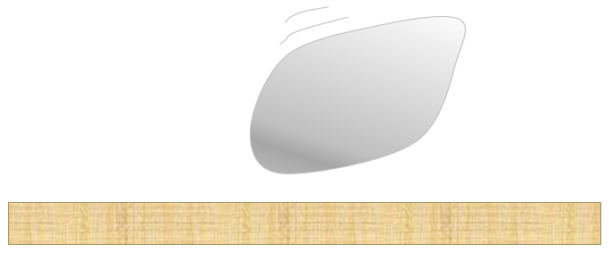
Wood-rock
Why is the sound made by the table a lot louder
than the sound made by the rock?
I am sure this is right
I think this is right
I think this is wrong
I am sure this is wrong
A
The table vibrates much more
B
The table is a lot bigger
C
It is the table that gets hit
D
The rock does not vibrate

